Slide 1
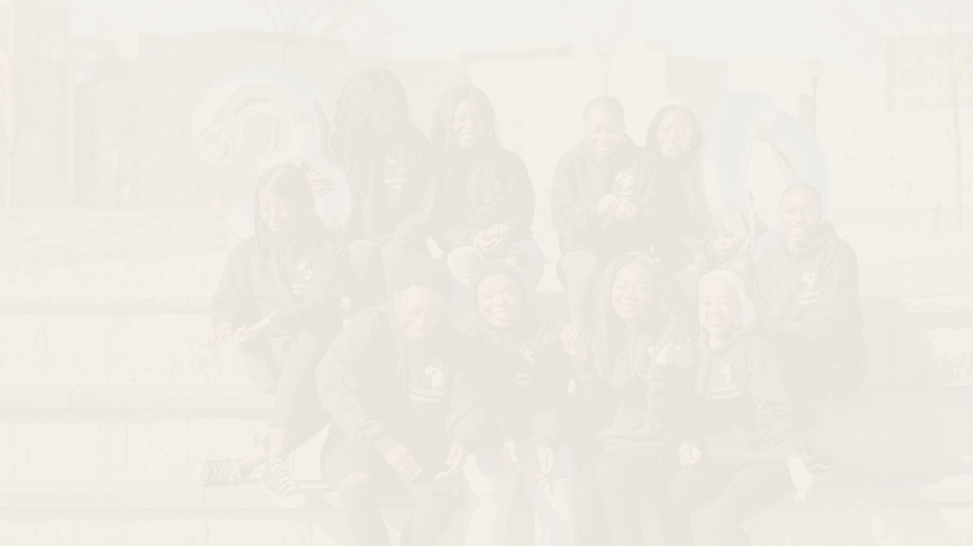

Rutgers
University TWESE

Slide 2



What is Twese?
An Organization for Africans and Friends of Africa. Since its establishment in 1991, it serves as a rich source for exploration and appreciation of African culture
The word Twese comes from the Kinya-Rwanda meaning of “UNITY”.
The focus of our organization is creating a safe space and comfort zone for our Africans students and our friends of Africa as well here at Rutgers.
We currently meet biweekly from 7:30-8:45pm on Wednesdays where we discuss ongoing topics in Africa and even around the world, with the hopes of betterment for Africa itself.

Slide 3
OUR MISSION
We strive to provide a sense of identity in the midst of cultural diversity.
TWESE presents opportunities for students to meet with their peers and establish relationships that go beyond their college experience while gaining access to many resources.

Slide 4


F A L L
Annual Events: The Banquet & Fashion Show
Banquet: Fall Semester
Fashion Show: Spring Semester
S P R I N G

Slide 5
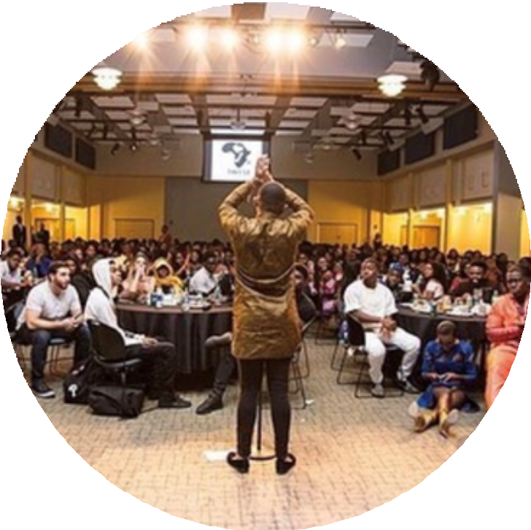
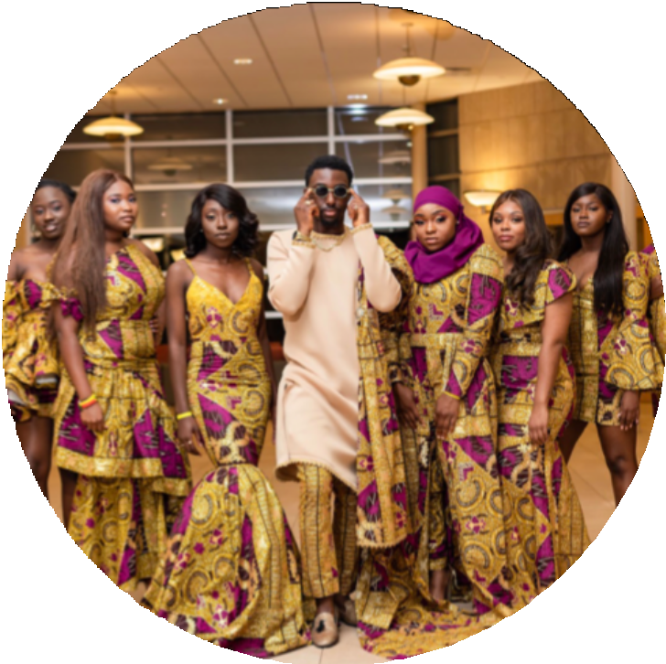
1) Banquet
Aids in showcasing African Culture
Each fall semester, we host a banquet to celebrate the greatness that the Twese organization has brought to the Rutgers community.
We have guest performances, which includes professors, students, and even Rutgers alumni to join us in our celebration in honoring Africa and African culture.
Our annual banquet is always open to everyone in the Rutgers community, including family and friends.

Slide 6
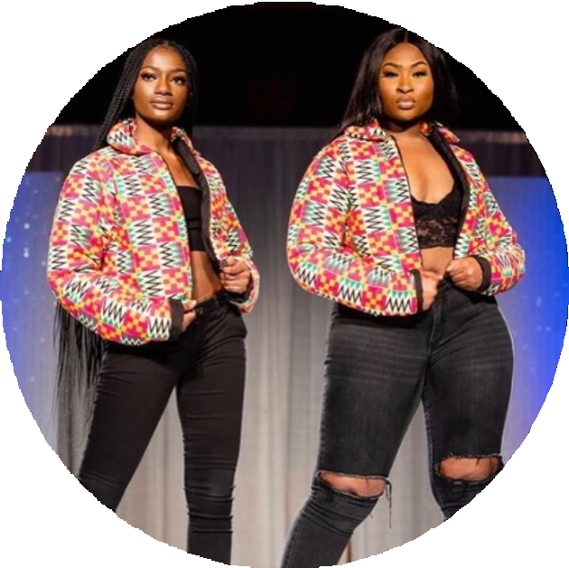
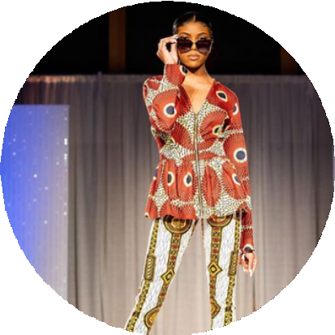
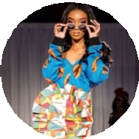
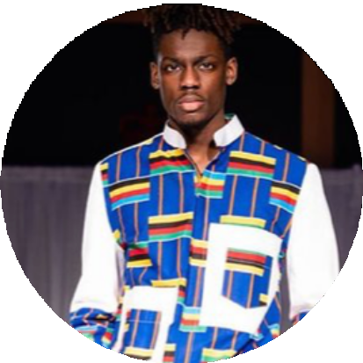
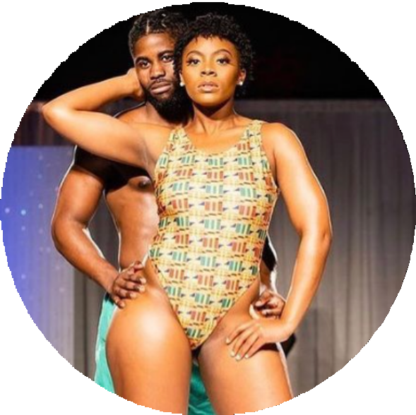
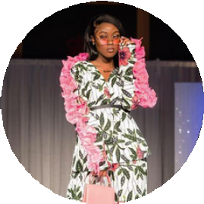
2)Fashion Show
Aids in showcasing African Culture
Each spring semester, we host the Fashion Show, our biggest event.
It is one of the most anticipated cultural events at Rutgers University.
We have about 400 attendees who dress in the most fashionable and traditional outfits every year, and March 2020, the event was completely sold out.
This event is open to all Rutgers students!
The executive board produces exotic themes for our fashion shows to make them more unique and diverse.

Slide 7
Costs &Funding
Expense Distribution | Cost
Advertising | $500
Room Rental Stage | $1200 $3000
Entertainment | $900 (DJ) $4000 (Performances)
Cultural Food | $1200 (Cocktail hour)
Decorations | $500 (VIP Supplies) $2500 (Supplies/Materials)
Costumes/Props | $3000 (Designers)
Other (Explain) | Makeup Artists $1000 Hair: $800 $2000 (Host) $700 (Photographer) $800 (Videographer) $200 (Hangers/Racks) $2300 (Fabric, Twese Dance Troupe costumes, 360 camera rental)
TOTAL PROGRAM COST: | $24,600

Slide 8

ANY
QUESTIONS?

